Slide 1
PROJECT TITLE Civigo: A Civic Education Game App
Team Members: Pavitha A(211423104439)
Pondavakam Keerthika
(211423104449)
Guide Name: mrs.vinmathi
Co-ordinator Name: Mr.C.Elangovan,
Mrs.Jaichitra Vasudevan I,
Mr.Ravindran U.
Batch no: 11

Slide 2
DOMAIN :Civic Education , Game
based learning
SDG Goal:
SDG 16: Peace, Justice and Strong Institutions
Relevant Target :
Target16.7: Ensure responsive, inclusive, participatory and representative decision-making at all levels.

Slide 3
Base Paper
Title: A Gamified Learning Framework to Cultivate Critical Thinking Skills in Students
Authors: K. G. Srinivasa, Aman Singh, Kshitij Kumar Singh Chauhan
Year: 2024
Publisher: IEEE
The paper introduces a gamified learning model designed to enhance critical thinking in students through interactive, scenario-driven challenges. It uses rewards, progression systems, and real-world problem simulations to maintain learner engagement.
It identifies drawbacks in current digital education tools such as low interactivity, lack of real-life application, and limited motivation mechanisms.
These drawbacks directly relate to CIVIGO’s motivation — our project solves these by integrating runner gameplay mechanics with real civic situations, making learning fun, interactive, and practical.

Slide 4
Abstract
Civigo is a scenario-based civics education runner game designed to make learning about governance, laws, and civic responsibilities engaging and interactive. The application integrates gamified elements with educational content, allowing players to navigate through virtual environments, face real-life civic scenarios, and answer quiz questions to progress. The game’s data flow involves player authentication, scenario and quiz retrieval, real-time gameplay interaction, answer evaluation, and progress tracking, all supported by Firebase and a scenario database. By combining entertainment with structured learning, Civigo aims to enhance civic awareness, critical thinking, and decision-making skills among players, particularly students. The project leverages modern mobile development frameworks and cloud-based services to deliver an accessible, interactive, and scalable learning platform.

Slide 5
Problem Statement (WHY?)
Many students and young citizens in India lack
awareness of their rights, duties, and basic civic laws.
Traditional teaching methods of civic education are often boring, theoretical, and hard to relate to real life.
This results in:
Low civic participation (voting, public involvement, etc.)
Misuse or ignorance of constitutional rights
Vulnerability to legal and civic exploitation
There's a gap between what is taught and what is practiced in society.
A need exists for an interactive, engaging, and practical way to learn civic concepts—especially among youth.

Slide 6
Proposed Solution
Develop an interactive mobile game app focused on teaching civic concepts in a fun and engaging way.
Use quizzes, scenarios, puzzles, and role-playing to simulate real-life civic and legal situations.
Cover key topics such as:
Fundamental Rights & Duties
Indian Constitution
Legal processes and everyday laws
Elections, governance, and citizen roles
Offer multi-language support to ensure accessibility for diverse users.

Slide 7
OBJECTIVES
To create an interactive mobile game that teaches civic concepts through engaging scenarios.
To promote critical thinking and decision-making skills related to governance and social ethics.
To provide accessible, game-based learning for students and the general public.
To measure learning outcomes through in-game analytics and feedback.
To encourage lifelong learning habits and active participation in civic life.

Slide 8
SIGNIFICANCE OF THE PROJECT
Civigo bridges the gap between theoretical civics education and real-life application.
By gamifying learning, it makes complex topics understandable and engaging for diverse age groups.
The project supports the development of informed, responsible citizens who can actively contribute to democratic processes and community well-being.
It also aligns with Sustainable Development Goals (SDG 4 & SDG 16) by promoting quality education and strengthening institutions through public awareness.

Slide 9
SOCIAL RELEVANCE / BENEFITS TO SOCIETY
Civigo addresses the gap in civic awareness by transforming traditional civics education into an engaging, interactive experience. It promotes active citizenship, fosters responsible decision-making, and nurtures an informed community. By simulating realworld civic situations in a safe, game-based environment, Civigo empowers players to understand laws, governance, and social ethics in a practical context.
Link to UN SDGs:
SDG 16 – Strengthens institutions through awareness and public participation.
Why It Matters: Textbook learning often fails to connect theory to real-life civic engagement. Civigo bridges this gap, motivating users to learn by doing — where their in-game decisions mirror real-world consequences. This fosters not just knowledge, but the habits of informed, responsible citizens.

Slide 10
INTRODUCTION
Civic education is vital for building responsible and informed societies. However, traditional teaching methods often lack interactivity, leading to disengagement and superficial understanding. Game-based learning, particularly scenario-driven gameplay, offers a powerful alternative by combining entertainment with educational depth. With the widespread use of smartphones, interactive civic simulations can now reach broad audiences, making learning engaging, accessible, and context-rich.
Motivation for the Project: The idea for Civigo came from recognizing the need to make civics education more relatable and enjoyable, especially for younger audiences. Scenario-based runner gameplay ensures players are actively engaged while learning, as they make choices in simulated civic dilemmas. Civigo aims to create a space where people can explore civic concepts safely, understand consequences, and internalize democratic values in an entertaining way.

Slide 11
LITERATURE SURVEY
R. Kumar & A. Singh (2024) – Developed a gamified learning framework to enhance critical thinking in students by integrating adaptive difficulty, interactive challenges, and feedback systems. The framework promotes analytical thinking and problem-solving through scenario-based tasks. Their experiments showed measurable improvement in higher-order cognitive skills. This approach is directly applicable to Civigo’s aim of fostering civic decision-making skills in an engaging way.
L. Trinidad, A. Calderón & M. Ruiz (2021) – Introduced GoRace, a narrative-driven and multi-context gamification suite designed to maintain learner motivation. It integrates storytelling, dynamic tasks, and multi-platform adaptability to address technological challenges in gamification. Case studies demonstrated increased learner participation and retention. Civigo can adopt similar story-based structures to make civic scenarios immersive and relatable.

Slide 12
V. Z. Vanduhe, M. Nat & H. F. Hasan (2020) – Combined the Technology Acceptance Model (TAM), Social Motivation theory, and Task-Technology Fit (TTF) to examine sustained gamification adoption in higher education. Results show that enjoyment, perceived usefulness, and social interaction drive continued engagement. The research emphasizes the need for interactive and community-driven
H. S. Setyaedhi (2023) – Applied gamification to animation courses by integrating points, badges, leaderboards, and achievement tracking. This approach increased student motivation, participation, and mastery of both 2D and 3D animation skills. Learners reported a more enjoyable and engaging classroom experience. Civigo can use these elements to make civic learning equally interactive and rewarding.
H. Vanduhe, V. Nat & H. F. Hasan (2020) – Reinforced earlier findings by confirming that ease of use, content relevance, and ongoing motivation are key factors in continued gamification use. The study advocates for regular updates and dynamic content to keep learners engaged. These insights are valuable for Civigo’s long-term sustainability.

Slide 13
S. Pappano (2019) – Studied the use of mobile educational apps to teach programming to high school students, highlighting benefits such as accessibility, interactive exercises, and instant feedback. Students showed improved comprehension and consistent engagement with learning content. The study confirms that mobile-first platforms are effective for modern education. Civigo’s design aligns with this approach, offering interactive learning via smartphones.
L. Sookhanaphibarn & W. Choensawat (2020) – Designed educational games aimed at improving cybersecurity awareness through realistic, scenario-based challenges. The games simulate real-world threats, allowing players to practice decision-making in a safe environment. Findings revealed higher knowledge retention and user engagement. Civigo’s civic cases can apply this model to teach laws and responsibilities in a similar experiential way.
T. Tang, V. Vezzani & V. Eriksson (2020) – Investigated the use of playful design jams to build creativity, problem-solving, and critical thinking skills. Participants worked collaboratively under time constraints to produce innovative solutions. This approach boosted teamwork and adaptability. Civigo could incorporate team-based civic challenges inspired by this methodology.

Slide 14
L. M. Tabuti, R. L. Rocha & R. Nakamura (2020) – Proposed a methodology to convert physical educational card games into digital versions to enhance logical reasoning skills. The process preserves original gameplay mechanics while adding interactivity and scalability. Experiments confirmed improvements in reasoning and engagement levels. Civigo can adapt this concept by digitizing civic decision-making activities.
L. Pitychoutis & F. Spathopoulou (2023) – Focused specifically on gamification in civic education, using badges, points, and scenario-based evaluations to increase engagement and civic competence. The study found higher participation and improved civic understanding among students. The findings strongly align with Civigo’s educational goals and mechanics.
Y. Sung & G. Hwang (2013) – Presented a collaborative game-based learning approach for science courses where students work together to solve challenges. The model led to better performance, improved peer learning, and increased student satisfaction. Civigo could adapt this collaborative format to encourage group discussions on civic scenarios.

Slide 15
S. Taylor, M. Lin & J. Petrosino (2019) – Developed IntelliBlox, a toolkit for integrating block-based coding into game-based learning. The system supports modular content and interactive gameplay. This modular design approach can be applied in Civigo to allow flexible creation of civic scenarios and quizzes.
H. Tacouri & L. Nagowah (2021) – Created Code Saga, a mobile serious game for learning programming using a story-driven approach. Players progress through a narrative while completing coding challenges, leading to better engagement and retention. Civigo’s storytelling elements can adopt this narrative integration to make civic learning more immersive.
J. Stigall & S. Sharma (2017) – Developed VR-based instructional modules for introductory programming courses, offering immersive experiences that improved conceptual understanding. Students reported higher motivation when engaging with VR tools. While Civigo is mobile-focused, similar immersive storytelling could be applied through 2D and 3D graphics.
J. Play (2017) – Conducted a survey of serious games in cybersecurity training, categorizing effective game mechanics, engagement strategies, and learning models. The study emphasizes the role of interactivity and feedback in achieving educational outcomes.

Slide 16
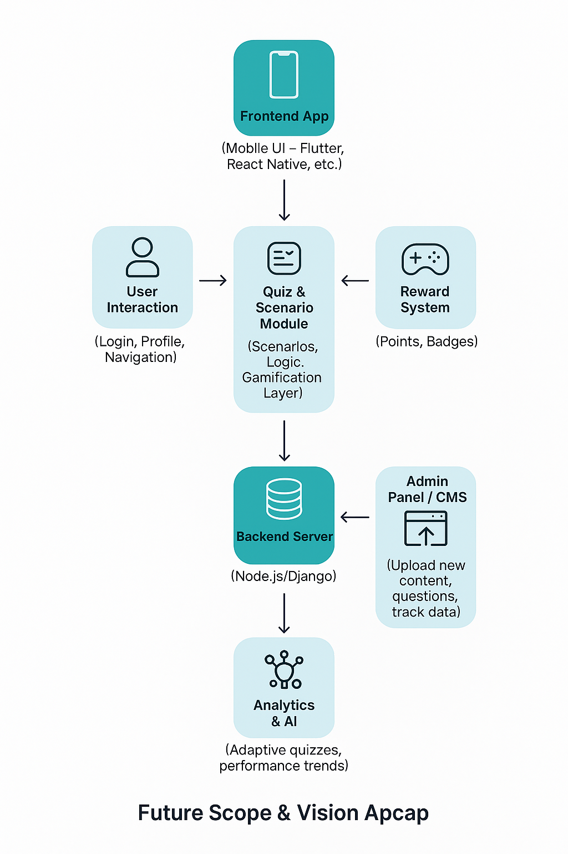
Proposed System
Architecture :

Slide 17
Software Specifications
Game Engine: Unity (Latest LTS version) – for game design, runner mechanics, and cross-platform builds.
Programming Language: C# – for scripting gameplay logic and scenario interactions.
IDE: Visual Studio – integrated environment for coding and debugging.
Backend Services: Firebase (Authentication, Realtime Database, Cloud Storage, Analytics) – for player data, leaderboard, and cloud saves.
APIs & SDKs: Google Play Services API (achievements, leaderboard), Unity Ads SDK (monetization), Google Maps API (location-based features if needed).
Design & Asset Tools: Adobe Photoshop / Illustrator (UI and 2D assets), Blender (3D models), Audacity (sound editing), Canva (basic graphic templates).
Testing & Deployment: Android Studio (APK build & testing), Xcode (iOS testing), Git/GitHub (version control), Unity Cloud Build (automated builds).

Slide 18
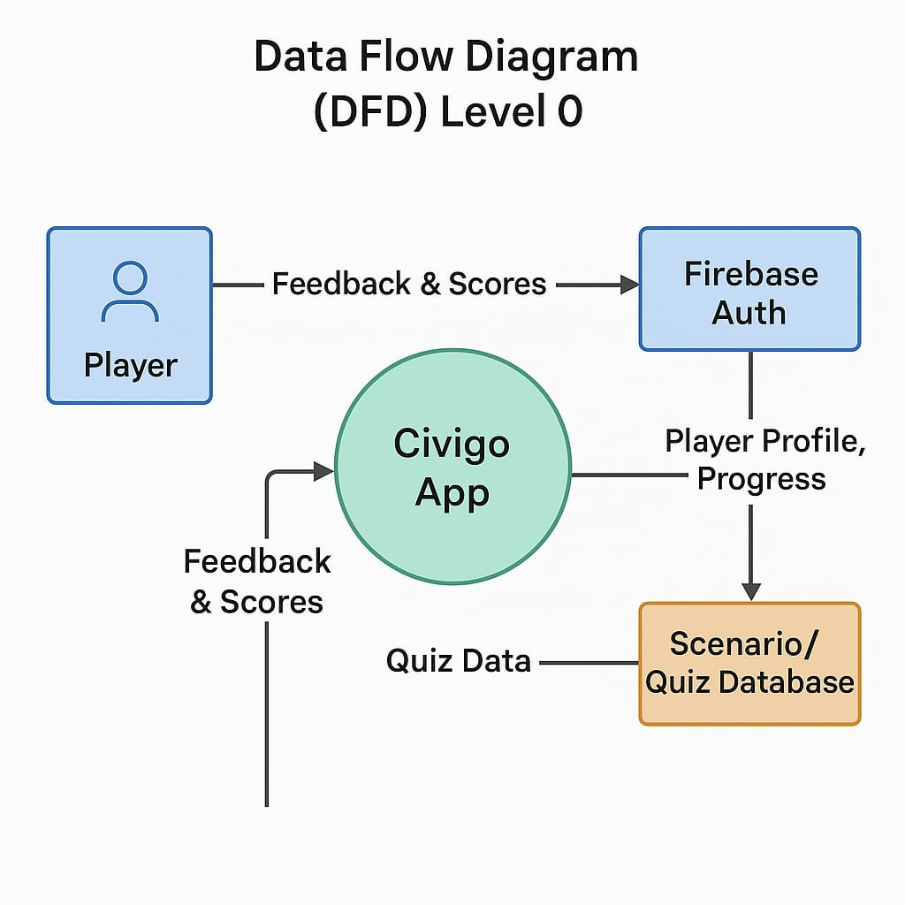
Data Flow Diagram (DFD) / System Architecture

Slide 19
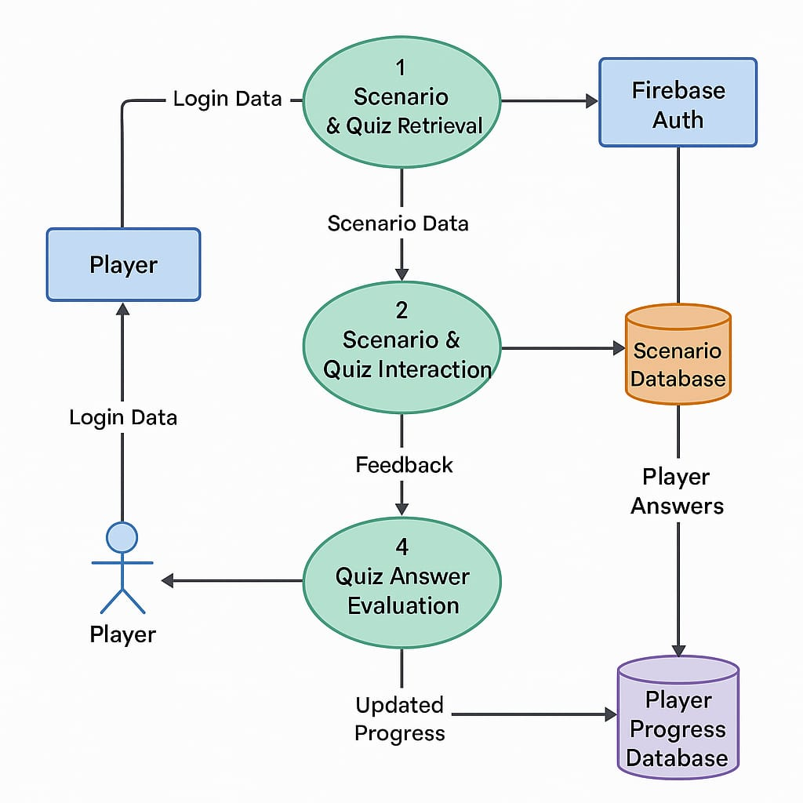

Slide 20
Modules
User Management Module
Features: User registration, login, role-based access (Student, Teacher, Admin), profile setup, avatar selection.
Purpose: Personalize experience, save progress, and support different user types.
Game Engine & Runner Mechanics Module
Features: Character movement, obstacle generation, speed control, and level design.
Purpose: Core gameplay logic to simulate a running environment with civic-themed obstacles and rewards.

Slide 21
Progress Tracking & Analytics Module
Features: Track user score, quiz accuracy, level reached, and time played.
Purpose: Provide feedback to users and educators on learning outcomes.
Content Management Module (Admin Panel)
Features: Add/update quiz content, civic topics, and game parameters.
Purpose: Ensure flexibility, easy updates, and curriculum alignment.
Security & Compliance Module
Features: Secure login, data encryption, privacy settings (COPPA, GDPR compliance).
Purpose: Protect user data, especially for minors.

Slide 22
Quiz Trigger & Learning Module
Features: In-game checkpoints triggering civic quizzes, instant feedback, timed answers.
Purpose: Reinforce civic concepts during gameplay in a fun and interactive way.
Gamification Module
Features: Points, badges, level progression, leaderboards, collectibles (e.g., rights scrolls, voting cards).
Purpose: Boost motivation and engagement through rewards and challenges.

Slide 23
Conclusion
Gamification and game-based learning significantly enhance student engagement, motivation, and knowledge retention.
Research highlights the value of narrative-driven content, scenario-based challenges, rewards, and collaboration in fostering critical thinking and problem-solving skills.
Frameworks like TAM and TTF stress usability, perceived usefulness, and social interaction for long-term adoption.
For Civigo, these insights provide a solid foundation to create an immersive, mobile-friendly civics education game that blends storytelling with structured learning, boosting civic awareness and decision-making skills.

Slide 24
Future Scope / Vision
Expand into a full civic learning platform covering Indian laws, rights, duties, and governance.
Launch certification-based modules for schools and colleges.
Integrate AI-driven personalized learning and analytics.
Add real-time civic news and interactive storytelling.
Collaborations:
NGOs & Civic Groups – for relevant and accurate content.
Government & Education Boards – for curriculum alignment and official adoption.

Slide 25
References
Kumar, R., & Singh, A. (2024). Gamified Learning Framework to Enhance Critical Thinking in Students. International Journal of Education and Development using ICT.
Trinidad, L., Calderón, A., & Ruiz, M. (2021). GoRace: Narrative-driven multi-context gamification suite for education. Computers & Education.
Vanduhe, V. Z., Nat, M., & Hasan, H. F. (2020). Gamification adoption in education: The role of enjoyment, usefulness, and social interaction. Education and Information Technologies.
Setyaedhi, H. S. (2023). Gamification in animation courses: Enhancing student motivation and participation. International Journal of Emerging Technologies in Learning.
Pappano, S. (2019). The use of mobile educational apps to teach programming to high school students. The Chronicle of Higher Education.
Sookhanaphibarn, L., & Choensawat, W. (2020). Design of educational games to improve cybersecurity awareness. IEEE International Conference on Teaching, Assessment, and Learning for Engineering (TALE).

Slide 26
Tabuti, L. M., Rocha, R. L., & Nakamura, R. (2020). Digitizing physical educational games to enhance logical reasoning skills. Simulation & Gaming.
Tang, T., Vezzani, V., & Eriksson, V. (2020). Playful design jams for enhancing creativity and problem-solving skills. International Journal of Child-Computer Interaction.
Vanduhe, H., Nat, V., & Hasan, H. F. (2020). Factors influencing the sustained use of gamification in education. Education and Information Technologies.
Pitychoutis, L., & Spathopoulou, F. (2023). Gamification in civic education: Increasing engagement and competence. Journal of Civic Education Research.
Sung, Y., & Hwang, G. (2013). A collaborative game-based learning approach for science courses. Computers & Education.
Taylor, S., Lin, M., & Petrosino, J. (2019). IntelliBlox: A toolkit for integrating coding into game-based learning. Journal of Educational Computing Research.
Tacouri, H., & Nagowah, L. (2021). Code Saga: A mobile serious game for programming education. IEEE International Conference on Computational Science and Computational Intelligence.

Slide 27
Thank you

